Slide 1
Theoretical and Practical Study of Robotics
Miguel Ruiz Nogués – S10002540

Slide 2

Introduction
“ Crear un robot para guiar a personas ciegas a través de un supermercado”

Slide 3
Actual Problem

Slide 4
Solution
“ Crear un robot para guiar a personas ciegas a través de un supermercado”

Slide 5
Advantages of the Solution

Slide 6
UML

Slide 7
Design

Slide 8
Technology Used

Slide 9

Economic Study
Hardware | Cuantity | Price
NXT Brick | 1 | 158.95 | $
NXT Ultrasonic Sensor | 1 | 32.95 | $
NXT Color Senosr | 3 | 17.95 | $
NXT Motor | 2 | 24.95 | $
Notebook Asus 1005HA | 1 | 250 aprox | $
Bluetooth Headphones | 1 | 10 | $
USB Bluetooth Device | 1 | 5 | $
 | TOTAL: | 560 | $
Software | Price
Ubuntu 10.04 | Free
Java | Free
leJOS | Free
Eclipse | Free
Free TTS | Free
SVN | Free
Sphinx 4 | Free
Objective: Low Budget

Slide 10
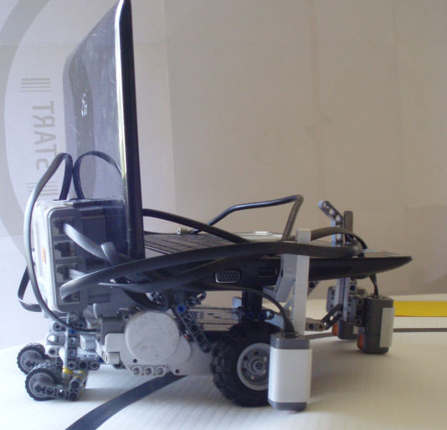
Demonstration
Video:

